Slide 1
R Crash Course (dplyr & ggplot2)
Dr Chirag Parsania
28th February 2025

Slide 2

What is Tidy Data

Slide 3
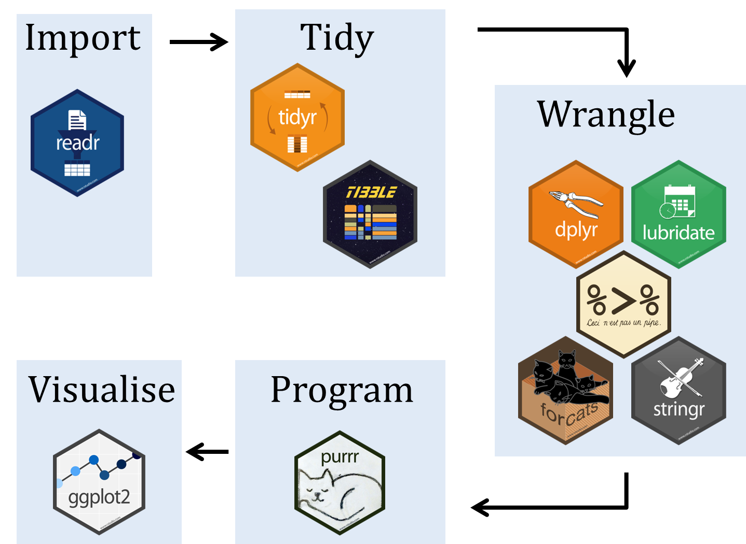
Introduction to Tidyverse
Tidyverse is a collection of R packages designed for data science.
Developed to make R more readable, efficient, and structured.
Includes dplyr, ggplot2, tidyr, readr, and more.

Slide 4
Base R vs Tidyverse: Syntax & Readability
Base R:
# Base R subset(df, column1 > 10) df$column2 <- df$column2 * 2
Tidyverse:
# Tidyverse df <- df %>%
filter(column1 > 10) %>% mutate(column2 = column2 * 2)
Base R uses a mix of different functions with varying syntax.
Tidyverse provides a uniform and consistent syntax across packages.
Uses ‘pipes’ (%>%) to streamline operations.

Slide 5
Visualization: Base R vs. ggplot2
Base R Plot:
plot(df$x, df$y, col='blue', pch=16)
ggplot2:
ggplot(df, aes(x, y)) + geom_point(color='blue')

Slide 6
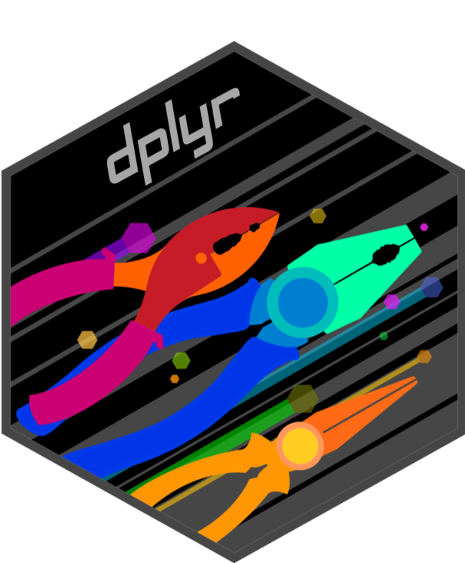
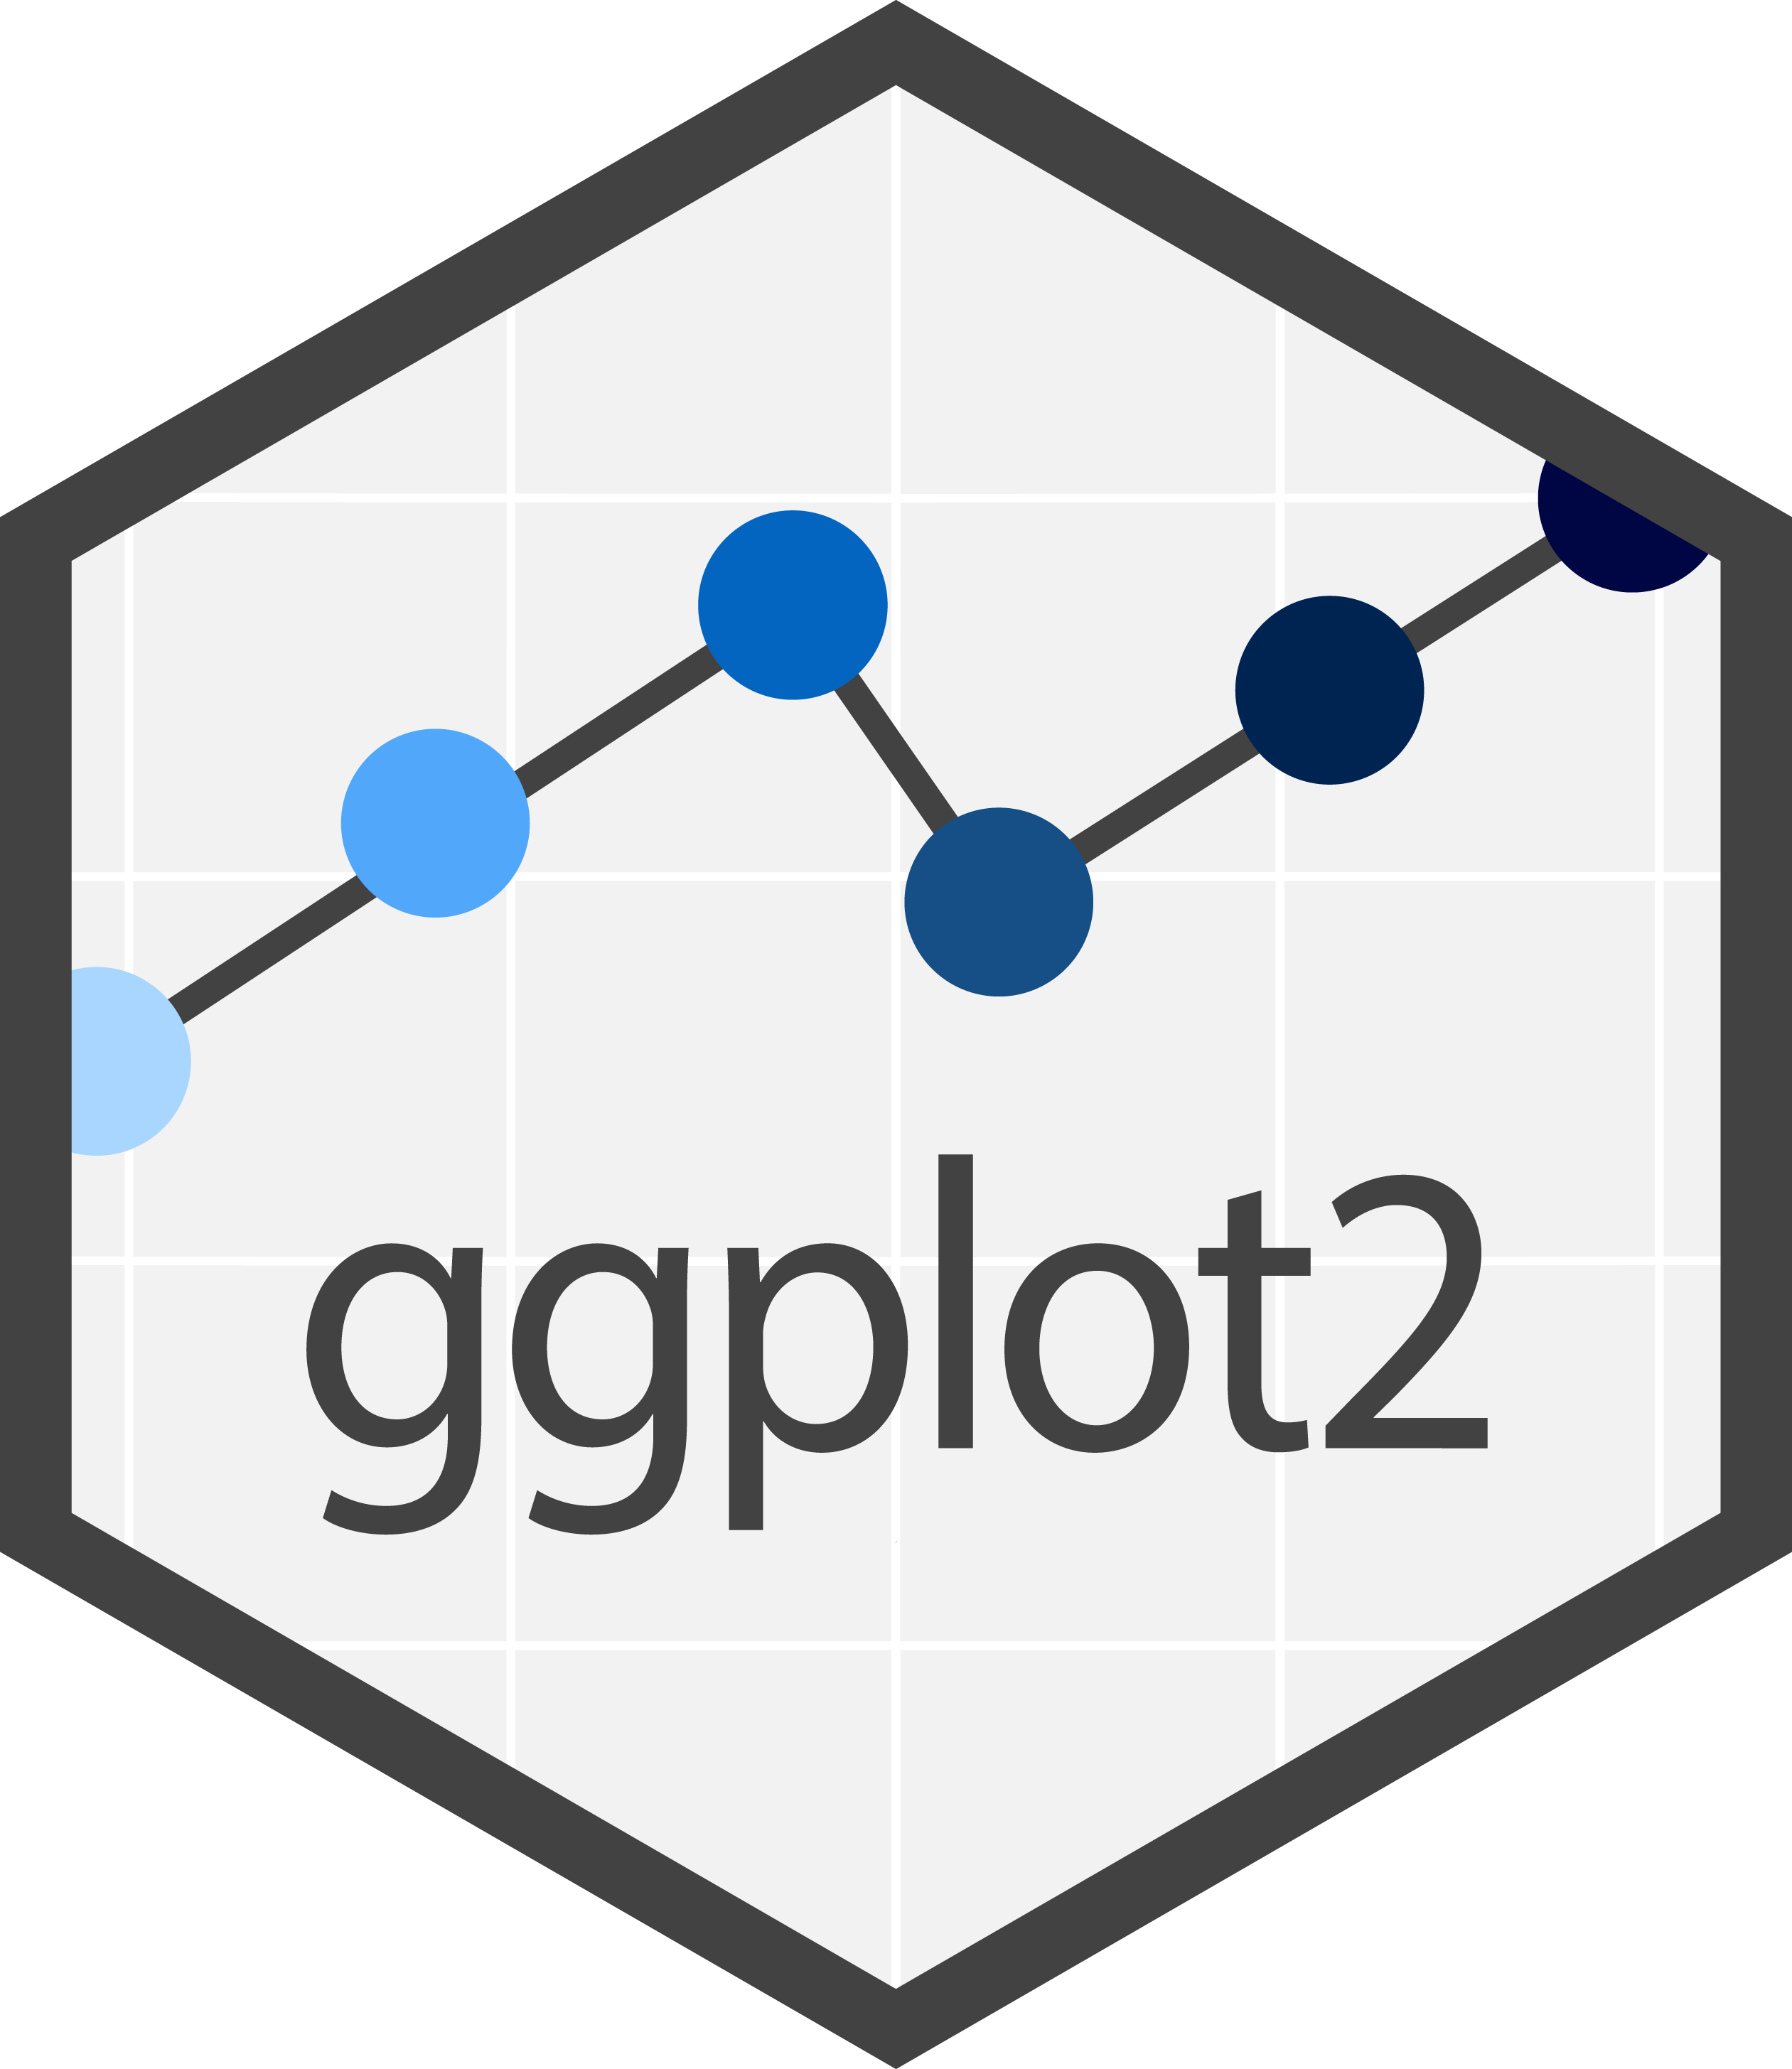
Today’s focus

Slide 7
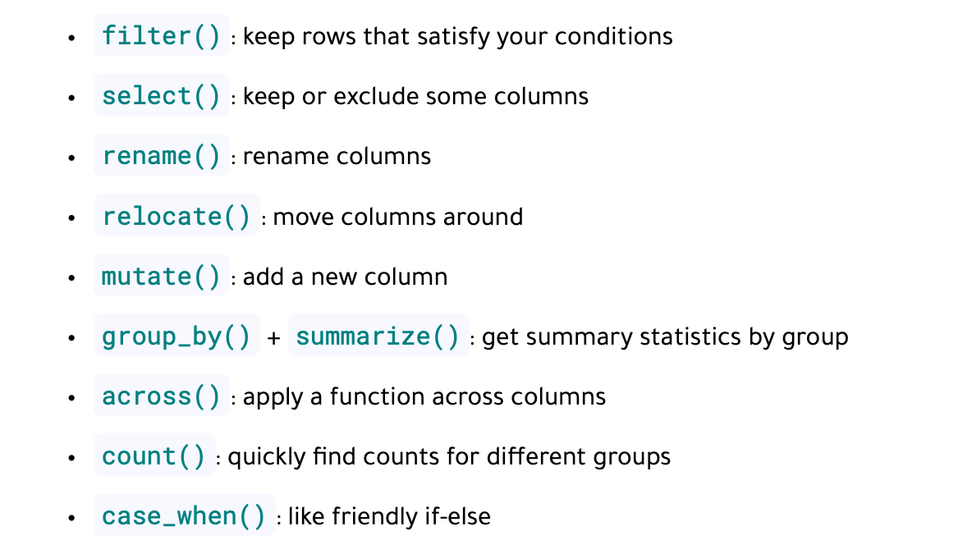
dplyr main verbs

Slide 8
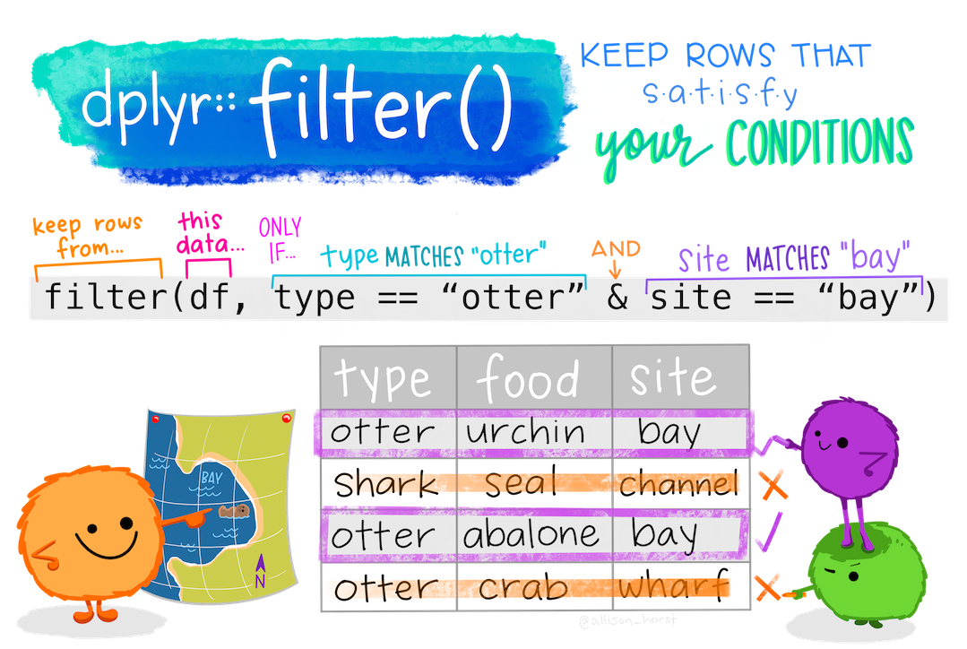
filter() rows from the table
Ref: https://allisonhorst.com

Slide 9
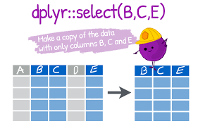
select(): select one or more columns

Slide 10
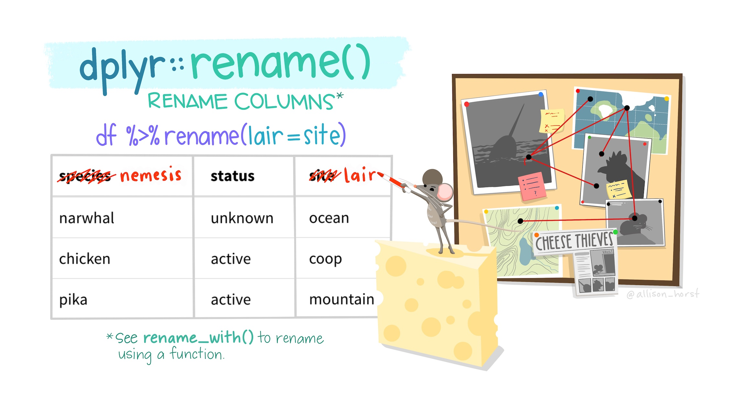
rename() column names
Ref: https://allisonhorst.com

Slide 11
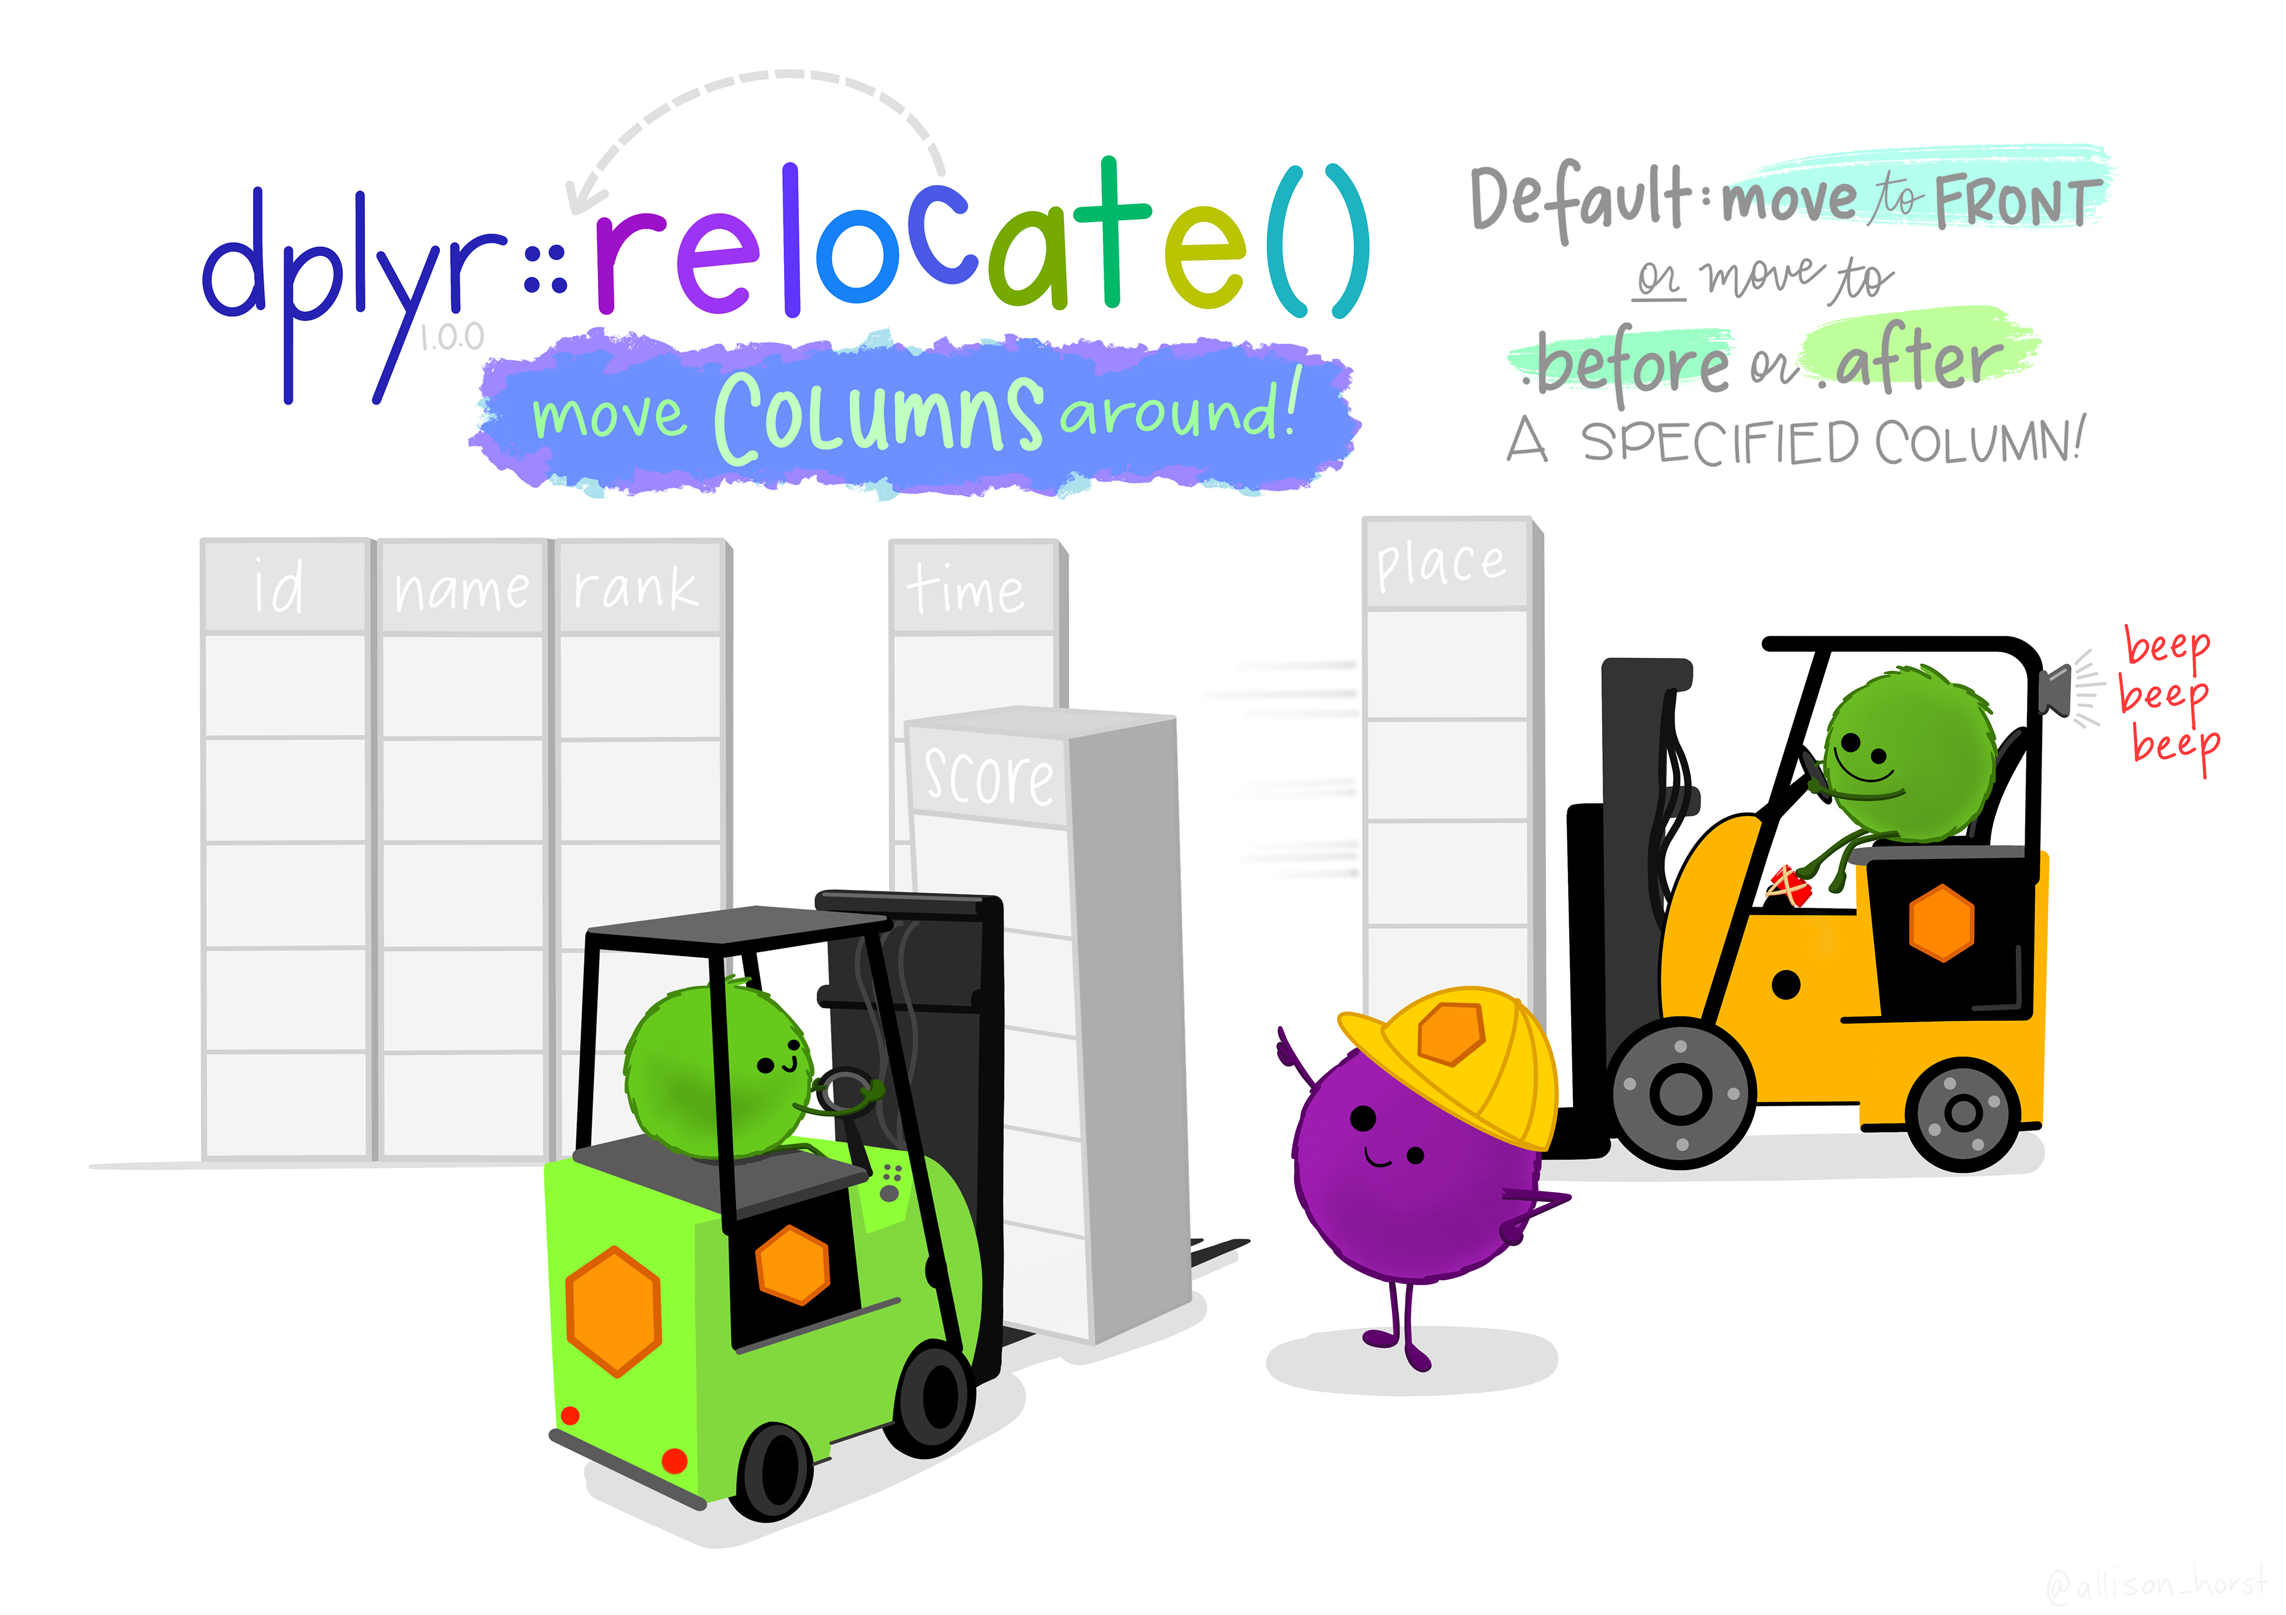
relocate(): move columns

Slide 12
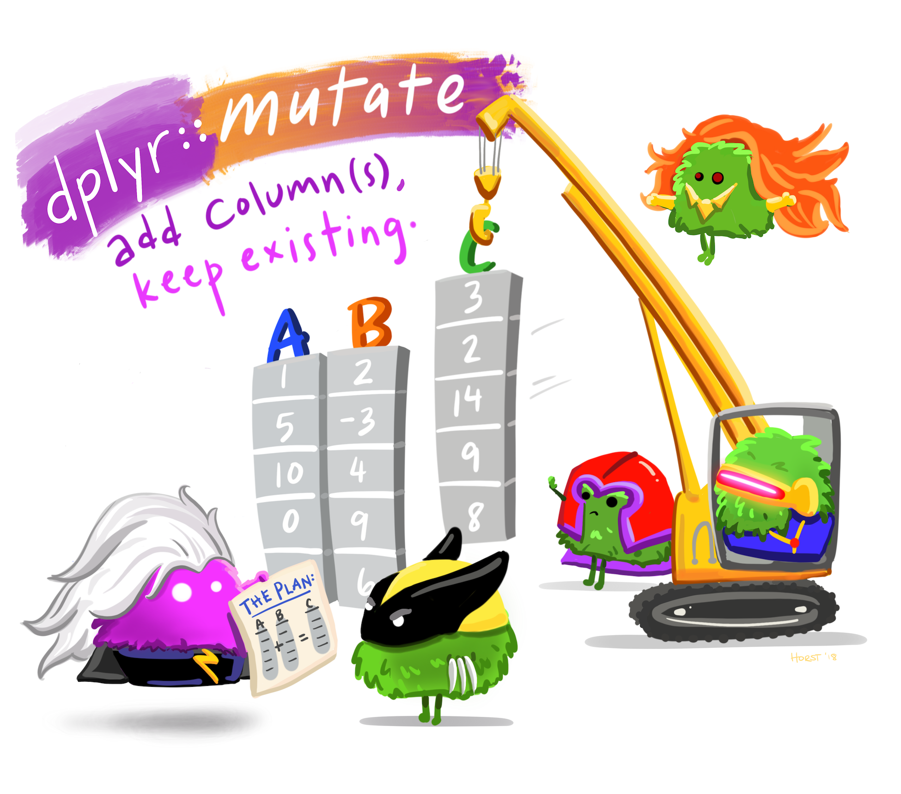
mutate(): add new or modify existing column
Ref: https://allisonhorst.com

Slide 13
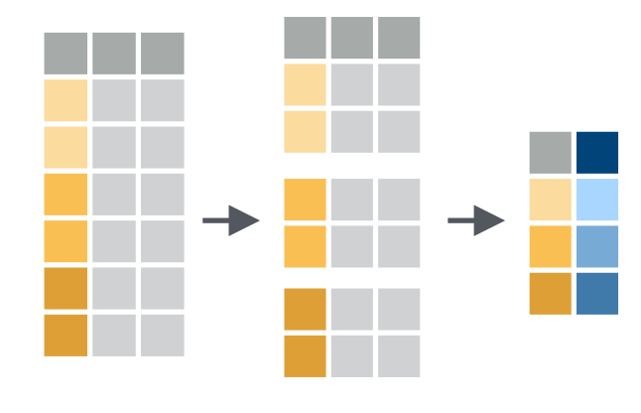
groupby() and summarise()
Ref: dplyr cheat sheet

Slide 15
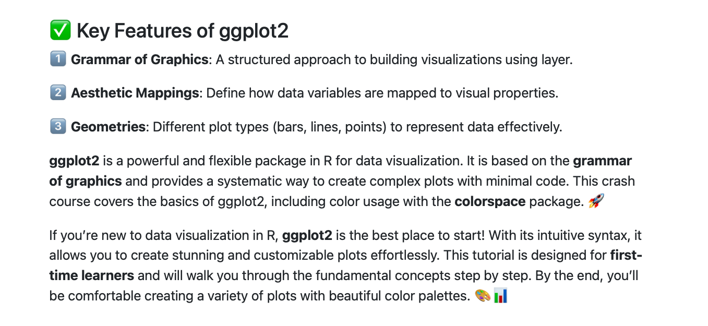
ggplot2

Slide 16
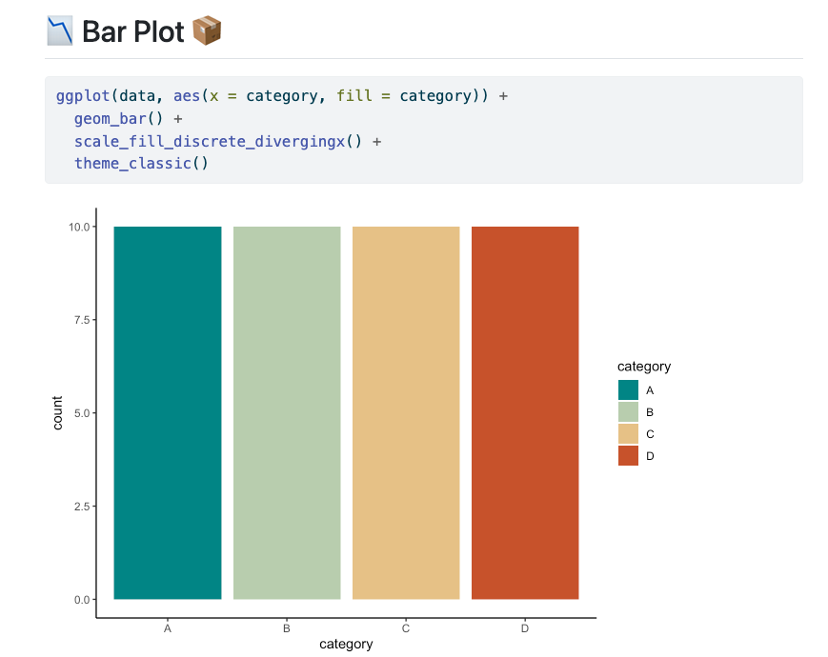

Slide 17
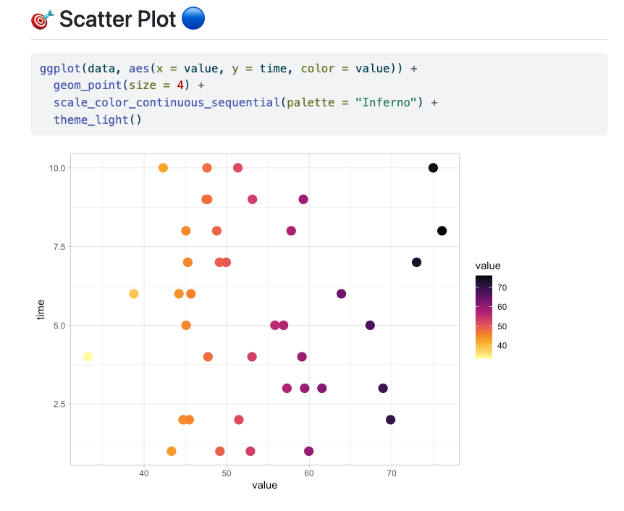

Slide 18
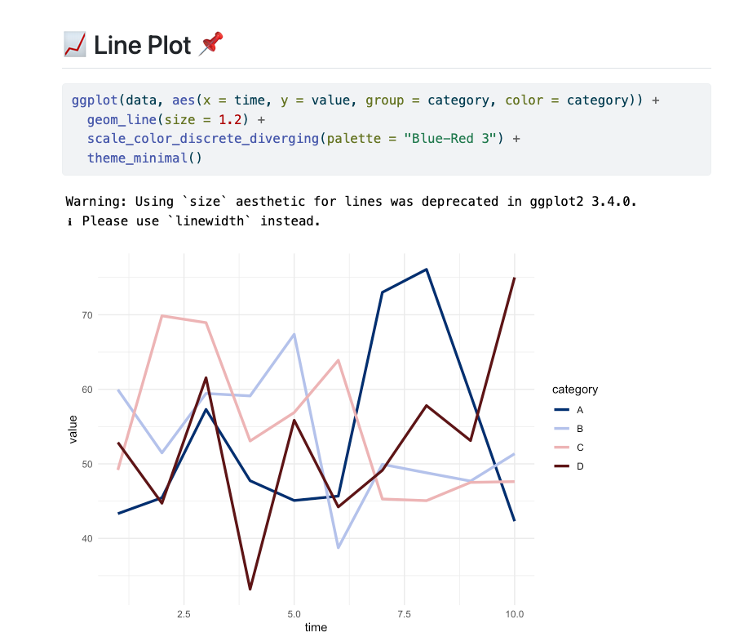

Slide 19
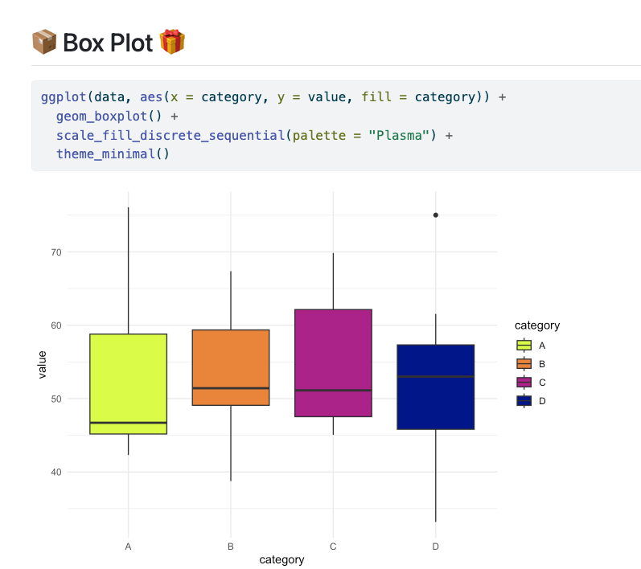

Slide 20
Useful resources
https://r4ds.had.co.nz/data-visualisation.html#common-problems
https://allisonhorst.com
https://www.tidyverse.org

Slide 21
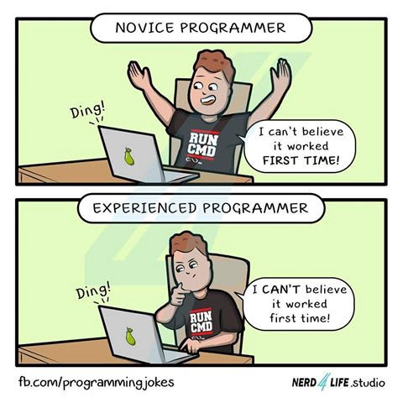
Time to do some real stuff

Slide 23

Scan to follow instructions

